Slide 1

WEEK 16
CESAR A. PASCAL VASQUEZ

Slide 2
The focus for this week was to learn more about the Unitree R1 and gather useful information for our research. At the same time, I continued working on improving the robot’s walking policy to achieve more stable and natural movement.

Slide 3
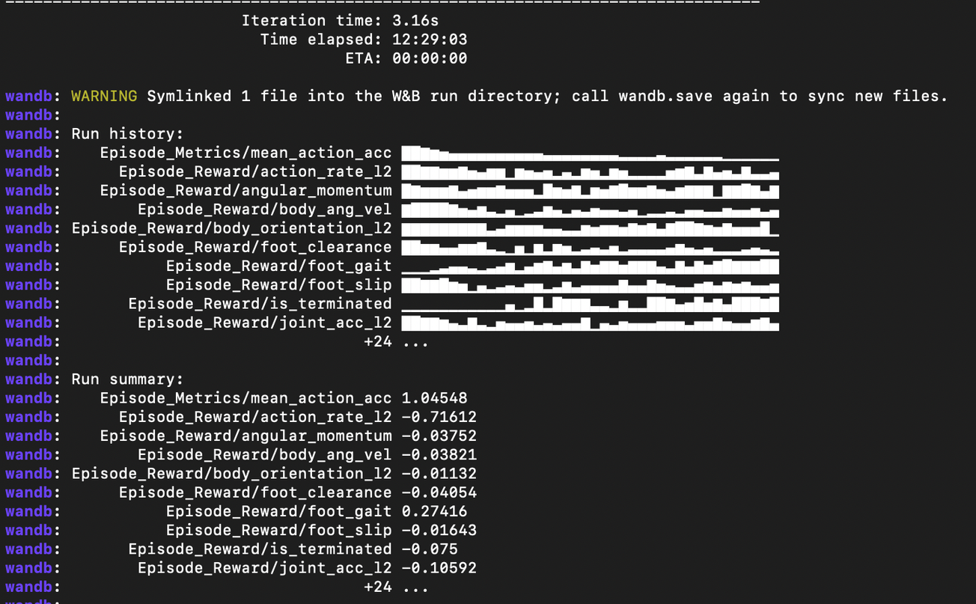
This week, I modified the walking policy and trained it for a longer period to obtain better results. The main goals were to improve the robot’s balance, prevent it from falling, and help it begin walking more consistently.

Slide 4
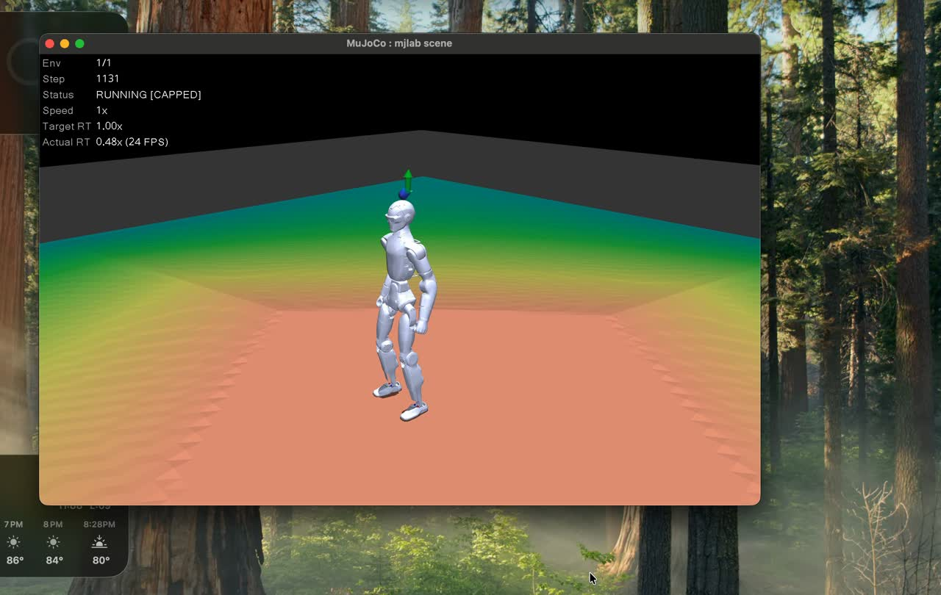
As observed, after more robust training, the R1 was able to maintain its balance properly and attempt to move forward. However, the reward function appeared to encourage the robot to lift its feet too high instead of producing a smoother and more effective walking motion.

Slide 5
Going forward, we will track several reward signals to evaluate the policy’s actual progress. An upward trend in foot_gait will indicate that a more consistent walking rhythm is developing, while is_terminated decreasing toward zero will show that the robot is falling less often and completing more stable episodes. A less negative foot_slip value will suggest that the feet are planting more effectively instead of sliding. Improvements in action_rate_l2 and joint_acc_l2 will also indicate smoother and less jittery movement. These signals will be monitored over time using TensorBoard, since long-term trends provide a more reliable measure of improvement or stagnation than individual snapshots.

Slide 6
This week, I also found an article titled Understanding R1-Zero-Like Training: A Critical Perspective, which may provide useful insights for our research. The article discusses important considerations related to reinforcement-learning-based training and may help us better understand how reward design, training stability, and policy evaluation influence the robot’s performance.

Slide 7
The article highlights several important lessons for reinforcement-learning practitioners. First, the quality of the initial model has a major influence on the final result, since training cannot easily compensate for a weak or poorly prepared starting point. Second, the training setup and initial instructions can strongly affect which behaviors emerge before reinforcement learning is applied.

Slide 8
The article also emphasizes that the reward function must be designed carefully to prevent the policy from exploiting unintended shortcuts. Although the article focuses on DeepSeek R1-Zero rather than the Unitree R1 robot, this point is especially relevant to our walking policy. For example, an improperly balanced reward may encourage the robot to lift its feet excessively instead of developing a smooth and efficient gait. This reinforces the importance of monitoring multiple reward signals and evaluating the robot’s actual behavior throughout training.

Slide 9
References
Liu, Z., Chen, C., Li, W., Qi, P., Pang, T., Du, C., Lee, W. S., & Lin, M. (2025). Understanding R1-Zero-Like Training: A Critical Perspective. arXiv. https://doi.org/10.48550/arxiv.2503.20783

